Slide 1
Putting current debates over California fuel taxes in context
Brian D. Taylor, PhD, FAICP
Professor of Urban Planning & Public Policy
UCLA Institute of Transportation Studies

Slide 2
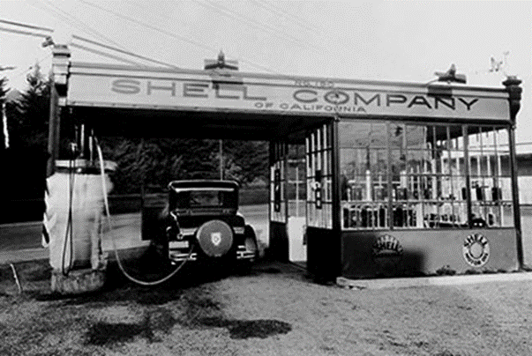
The California motor fuels tax
In the early 1920s
More than 40 percent of the state budget was going to direct appropriations for highways and interest payments on road bonds
This was unsustainable
So in 1923 California adopted an earmarked user fee for transportation: the per-gallon fuel tax
A smashing fiscal and political success

Slide 3
This 102 year-old fuel tax has many upsides…
It still generates a lot of revenue
Especially after the passage of Senate Bill 1 in 2017
California’s levy is at the high end among states, but not the highest
It is as much a user fee as a tax
Is perceived as fair in that heavy users of the road system pay more, while light users pay less
Status as a user fee makes it easier politically to (mostly) earmark funds for transportation purposes

Slide 4
The current state fuel tax has many upsides… (cont.)
It is cheap and easy to collect
Levied on just a few wholesalers; administrative costs are low, and cheating and evasion are rare
It supports environmental goals
Essentially a tax on burning fuel, and so it nudges travelers toward both vehicle efficiency and greener propulsion systems

Slide 5
…But it has several downsides as well
Requires a heavy political lift just to stay even
It is a cents/gallon levy that is insensitive to both rising construction and maintenance costs and increasing fuel efficiency
As a result, it gradually “sunsets” over time as the buying power of the fuel tax inevitably erodes
Raising the tax levy tax to make up for the eroded buying power, but this is a political challenge
Federal fuel tax has not changed in 32 years
California has largely overcome this with indexing – but this can be politically unpopular when rates increase frequently

Slide 6
…But it has several downsides as well (cont.)
The fuel tax revenue base is eroding over time
As the share of electric and hydrogen fuel-cell vehicles in the fleet increases
This is perhaps fine early on as a way to incentivize zero-emission vehicle (ZEV) sales
But increasingly problematic as the ZEV share of the fleet grows

Slide 7
ZEVs are an important advance, but…
They impose costs on society as well
Heavy vehicles disproportionately damage roads
Battery electric cars and trucks (EVs) weigh more than similar internal combustion engine (ICE) vehicles
Many EVs accelerate very quickly, which may increase crash risks
EVs contribute to traffic congestion like all cars and trucks
All of these effects vary by miles driven, but a flat annual fee does not reflect this variance as the motor fuels tax does

Slide 8
To evaluate the fuel tax and what might come after requires agreeing on its purpose
Goal #1: Raise revenue
From transportation (fuel tax, tolls), for transportation
Common in the U.S.
From transportation, for other public purposes
Common in other countries
From general sources, for transportation
Like countywide local option sales taxes in California

Slide 9
To evaluate the fuel tax and what might come after requires agreeing on its purpose (cont.)
Goal #2: Link who pays to who benefits
Fuel taxes consistent with a costs imposed/benefits received fairness principle
Drive more, pay more
Heavy vehicles that tend to damage roads and pollute more, to pay more

Slide 10
To evaluate the fuel tax and what might come after requires agreeing on its purpose (cont.)
Goal #3: Influence behavior
Fuel taxes (modestly) encourage drivers to burn less fuel, drive lighter cars, acquire low-/no-emission cars, drive more sparingly, travel via greener modes
New forms of charging for road use could influence behavior more directly and effectively
Thereby lower transportation revenue needs
While shifting to revenue collection unrelated to driving may motivate travelers to drive more than in the case with fuel taxes
Which could increase transportation revenue needs

Slide 11
To evaluate the fuel tax and what might come after requires agreeing on its purpose (cont.)
Fuel tax is likely to gradually evolve toward becoming a “sin tax”
As the base of internal combustion vehicles declines over time…
And revenues for transportation increasingly come from other sources
The focus of the tax will likely shift away from generating revenues and toward discouraging fuel consumption
Called a “Pigouvian” tax on negative externalities by economists
Like taxes on cigarettes to discourage smoking, the ultimate goal would be to eliminate burning fuel, which will drive revenues to zero
Though this transition is likely still many more years in the making

Slide 12
Closing thought: Transportation needs, and revenues to pay from them, should not be thought about separately
Transportation needs, raising revenues, charging fairly, influencing behavior…
All four are linked (and at times at odds), no matter how transportation revenues are collected
We can collect revenues for transportation from general taxes (like on income and sales) unrelated to driving and parking
This shields drivers from the social costs of driving and parking, which encourages them to travel more
Thereby increasing transportation system needs
Or we can collect revenues from transportation user fees (like fuel taxes and tolls)
This makes drivers more aware of the social costs of driving and parking, and more judicious in their travel as a result
Thereby reducing transportation system needs

Slide 13
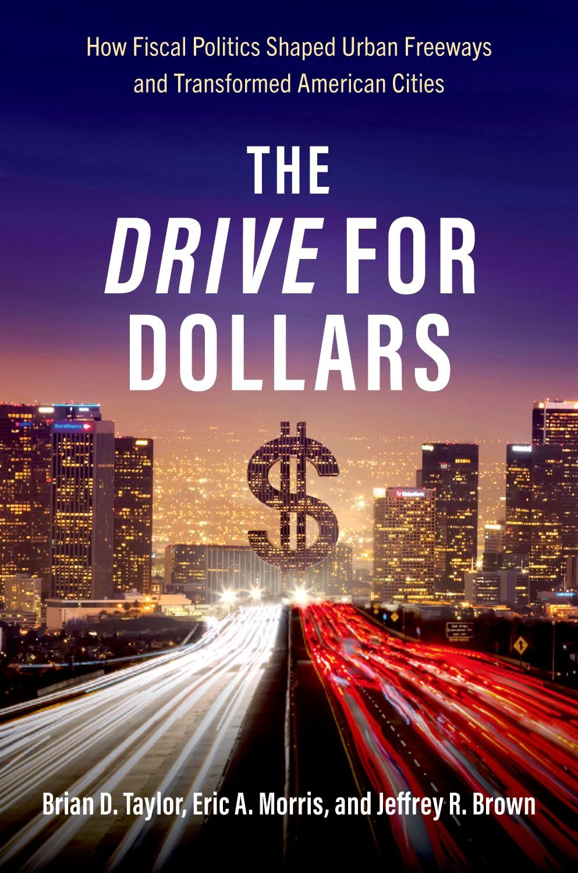
Brian D. Taylor, PhD, FAICP
btaylor@ucla.edu
Professor of Urban Planning and Public Policy
UCLA Institute of Transportation Studies
Find research reports and policy briefs at its.ucla.edu

