Slide 1
2024 Draft Business Plan
March 11, 2024
Presented to the Assembly Transportation Committee

Slide 2
2024 Draft Business Plan
Required by PUC Section 185033
Every two years (even years)
2022 Business Plan
Included limited updates to forecasts at the time
COVID impacted release date of final 2020 Business Plan to 2021, so the 2022 updates were more limited
2023 Program Update Report (PUR)
Provided more time to work through forecasts and estimates
Keystone document re-laid foundation for forward direction
Updated cost and schedule estimates for Merced to Bakersfield segment
Specified Merced to Bakersfield segment would be built as a dual-track, electrified railroad with a shared station in Merced
2024 Business Plan
Significant program progress since 2023 PUR
Still aligned with 2023 PUR direction, schedule, budget and vision
Where we plan to go, notably with $3.1B Fed-State funding granted in December 2023
Discussion about risk identification, management and mitigation

Slide 3
2023 Project Update Report
Released in March 2023:
Set a target schedule for an Early Operating Segment (Merced to Bakersfield) to be ready for passenger service between 2030 and 2033 schedule envelope (in line with FRA and FTA guidelines)
Updated cost estimates based on escalation and inflation, scope increases and risk analysis
Set a funding strategy informed by CA Legislative budget decisions and the federal Bipartisan Infrastructure Law
Established new Ridership/Revenue forecasts based on new model developed by Authority’s Early Train Operator in coordination with CalSTA
Updated Program Baseline Budget/Schedule informed by funding, finalizing commercial agreements, and Track and Systems
CP 1: 2026
CP 2-3: 2026
CP 4: 2023 (substantially complete)
Set targeted goals for critical procurements such as track and systems, trainsets, station and extension design
Notes:
Laid the foundation for the 2024 Business Plan

Slide 4
2024 Draft Business Plan Key Updates
2024 Draft Business Plan maintains the cost and schedules from 2023 PUR, released 11 months ago
Merced to Bakersfield – The costs estimates are unchanged from the 2023 PUR. While the cost estimates are unchanged, the BP will update on cost risks for each construction package, with CP 2-3 carrying the highest risk due to:
Impacts of 2022/2023 flooding
A major change order in arbitration
Major third-party issues to be resolved
A final Revised Baseline schedule still in negotiation
Phase 1 cost updates are pending completion of environmental documents for two Southern California sections.
Palmdale to Burbank EIS/EIR is expected to come to the Board in Q2 2024
LA to Anaheim is working on Supplemental Alternatives Analysis with EIS/EIR in 2025.
Analysis to date suggests cost for these two sections at the higher cost range as reported in the 2023 PUR.
However, total cost estimate for Phase 1, after environmental documents are certified, will remain in the range of costs identified in the 2023 PUR

Slide 5
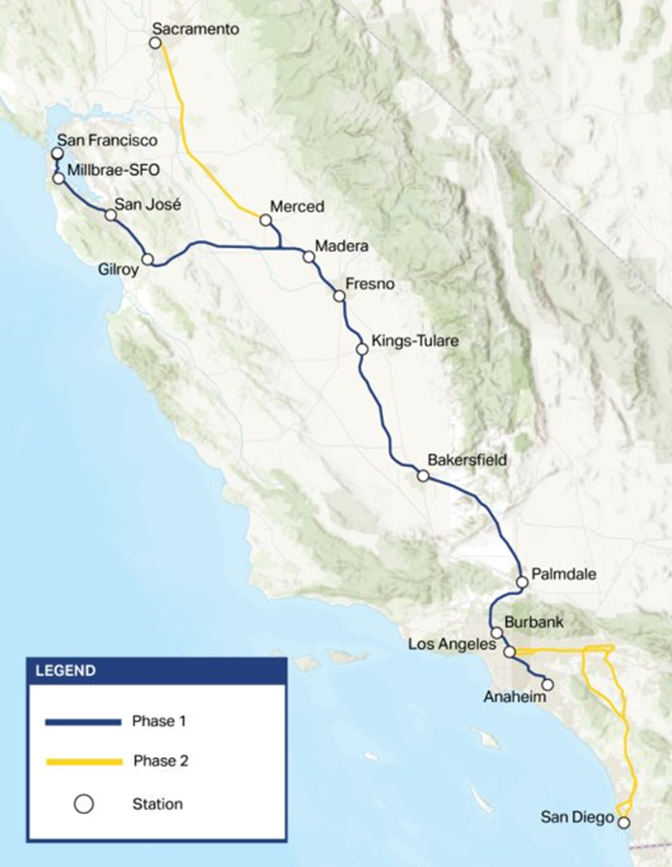
Major Accomplishments Since 2023 Project Update Report
Awarded $3.3 billion in new federal funds federal government (reinvested/renewed partnership)
Advanced procurements to move the project toward operations
First construction package (CP 4) covering 22.5 miles in Central Valley near completion
Construction jobs exceeded 12,200 in 2023, record high numbers for daily workers on job sites, and record number of structures completed
Exceeded goals for the percentage of right-of-way parcels acquired (98%) and the number of utilities relocated in a single year (250+)
Met contract milestones, keeping design designs for the extensions to Merced and Bakersfield on schedule
Notes:
2023 PUR was released almost a year ago and reset the Authority’s ridership and funding goals.

Slide 6
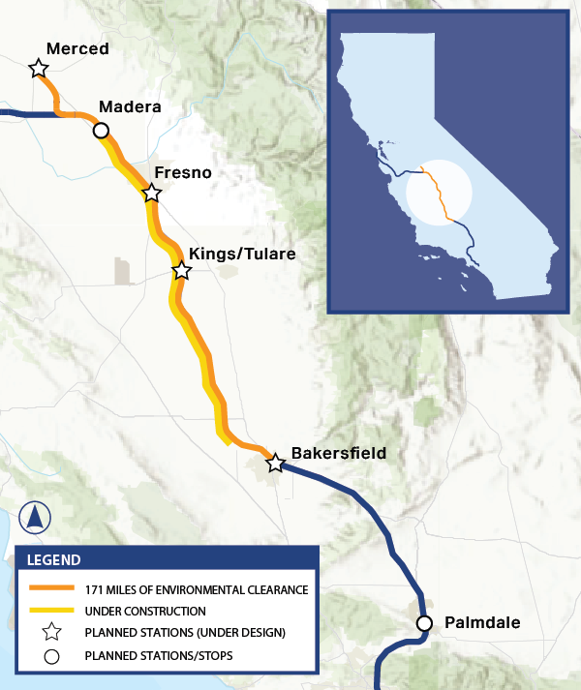
Central Valley Progress
Completed 17 structures
Improved right-of-way planning and management resulting in 98% parcels delivered
Increased executive engagement and third-party task force efforts, resulting in 97% of third-party agreement and design approvals
Finalized revised baseline schedules for CP 1 and CP 4, working on revised baseline schedule for CP 2-3
Funding to support final design and right-of-way for the Merced and Bakersfield extensions

Slide 7
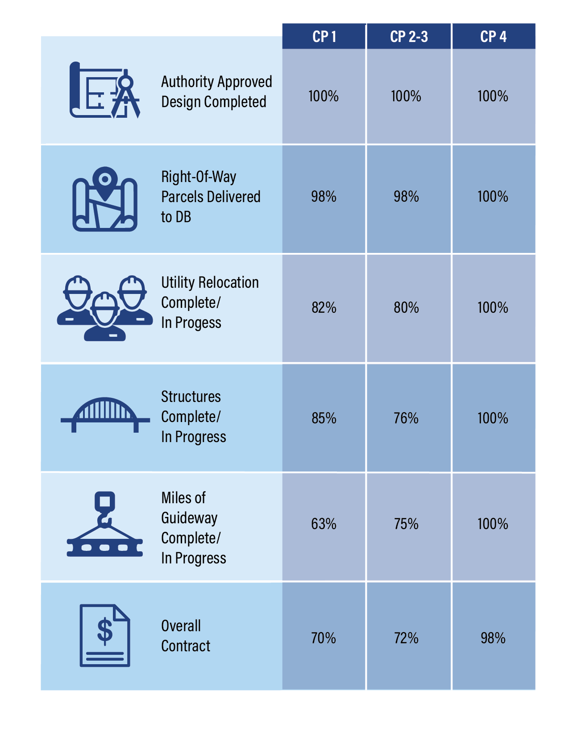
Central Valley Progress
Reached 100% design completion for all construction packages
Design, Right-of-Way, Utilities Relocations project to be nearing completion in 2024
Structures and Guideways continue to progress forward
Construction Packages are on schedule
CP 4 Reached substantial completion
CP 1 Completion in 2026
CP 2-3 Completion in 2026
Stage | CP 1 | CP 2-3 | CP 4
Authority Approved Design Completed | 100% | 100% | 100%
Right of way parcels delivered to DB | 98% | 98% | 100%
Utility Relocation Complete/In Progress | 82% | 80% | 100%
Structures Complete/ In Progress | 85% | 76% | 100%
Miles of Guideway Complete/ in Design | 63% | 75% | 100%
Overall Contract | 70% | 72% | 98%

Slide 8
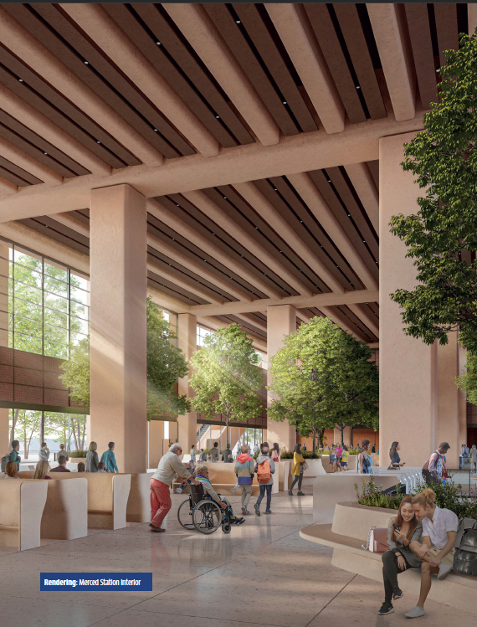
Stations
Collaborating with officials and stakeholders for pre-rail activities
Gathering feedback for successful station site planning
Schedule
Contract executed in March 2023
Completed concept designs for all four stations in November 2023
Continuing design work in 2024 for schematic design phase

Slide 9
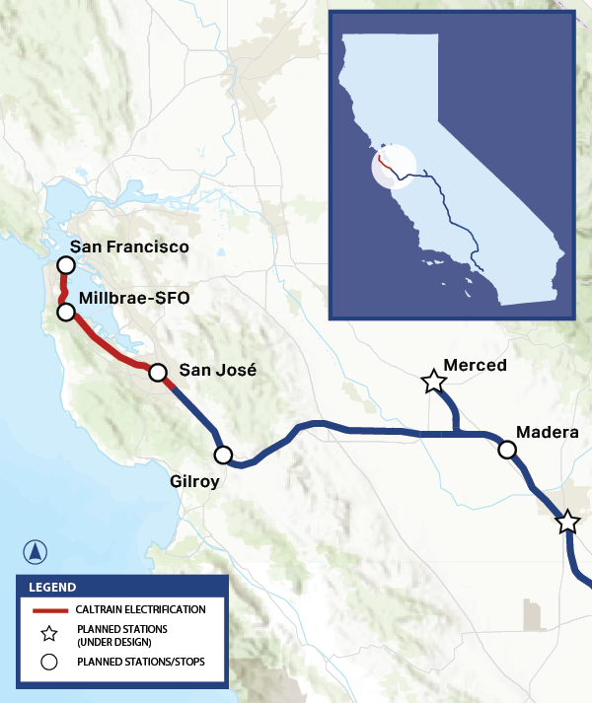
Northern California
Completed environmental clearance, preparing for advanced design
Integration with existing rail networks, including $700+ million investment in Caltrain corridor electrification
Portal (Downtown Extension Project) linking rail line to Salesforce Transit Center
Diridon Integrated Concept Plan for transforming Diridon Station into intermodal hub
Actively seeking additional funding for design work and geotechnical studies in Pacheco Pass to link to Central Valley

Slide 10
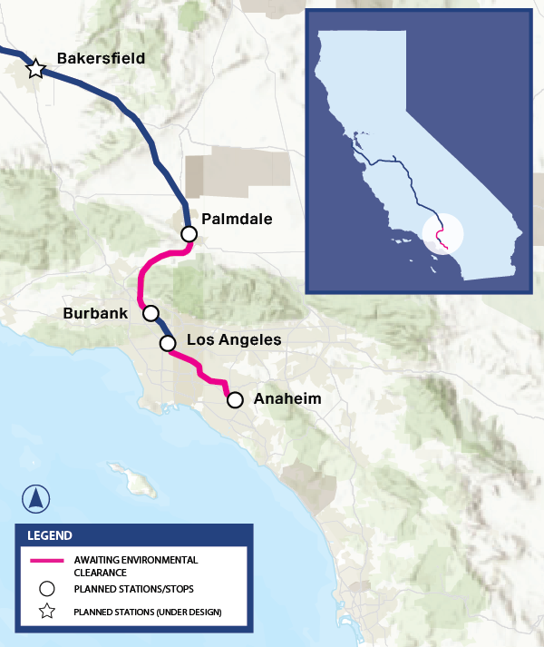
Southern California
Focus on enhancing regional connections and infrastructure, funding early projects, and completing environmental clearance
LA Metro's Rosecrans and Marquardt Avenue Grade Separation to be completed in early 2025
Draft Environmental Impact Report (EIR) for Palmdale to Burbank section released in fall 2022, Final EIR/EIS expected this summer, marking complete environmental clearance
Exploring a connection to Brightline West via High Desert Corridor, extending to Las Vegas

Slide 11
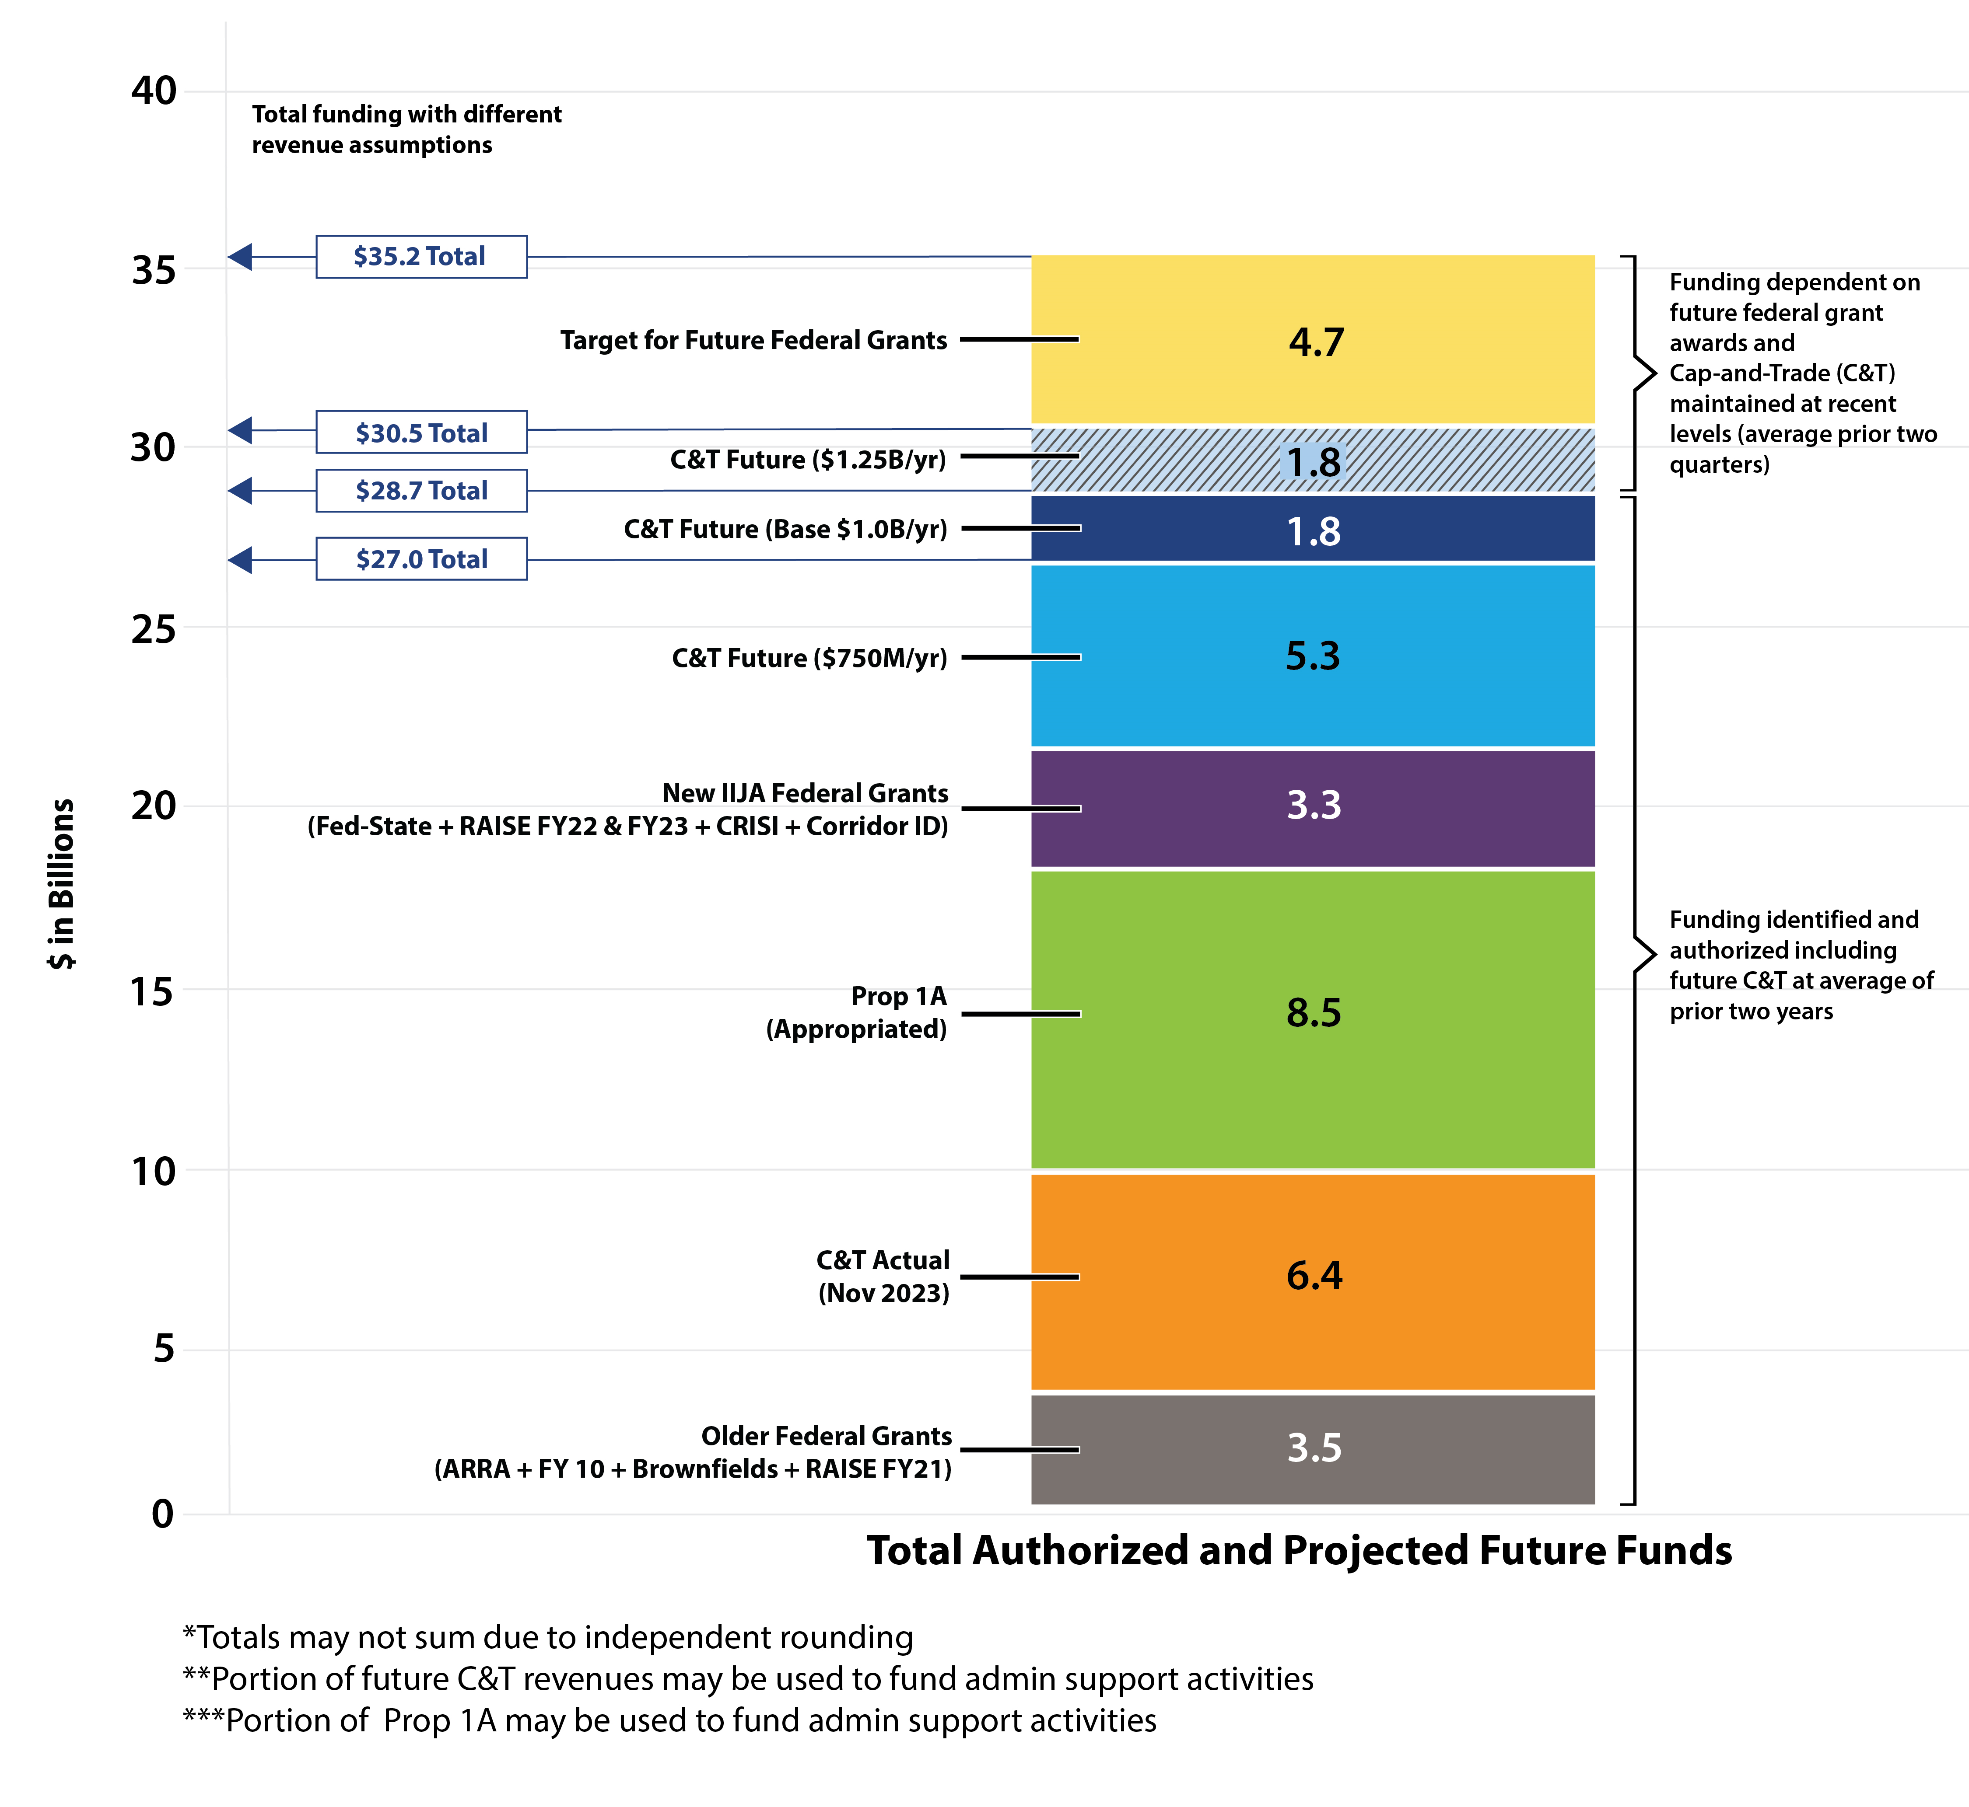
Funding the Program
The Authority committed to securing funding for the Merced to Bakersfield extensions
Funding efforts include $4.2 billion from Proposition 1A and Cap-and-Trade allocations
Developed an approach to secure $8 billion in new federal grants over the next five years
$3.3 billion in federal grants obtained so far, with ongoing efforts to secure additional funding
Seeking another $4.7 billion from the Federal-State Partnership (FSP) National Program and other BIL programs
Current and projected funding of $27 billion to $30.5 billion assuming Cap-and-Trade revenue scenarios

Slide 12
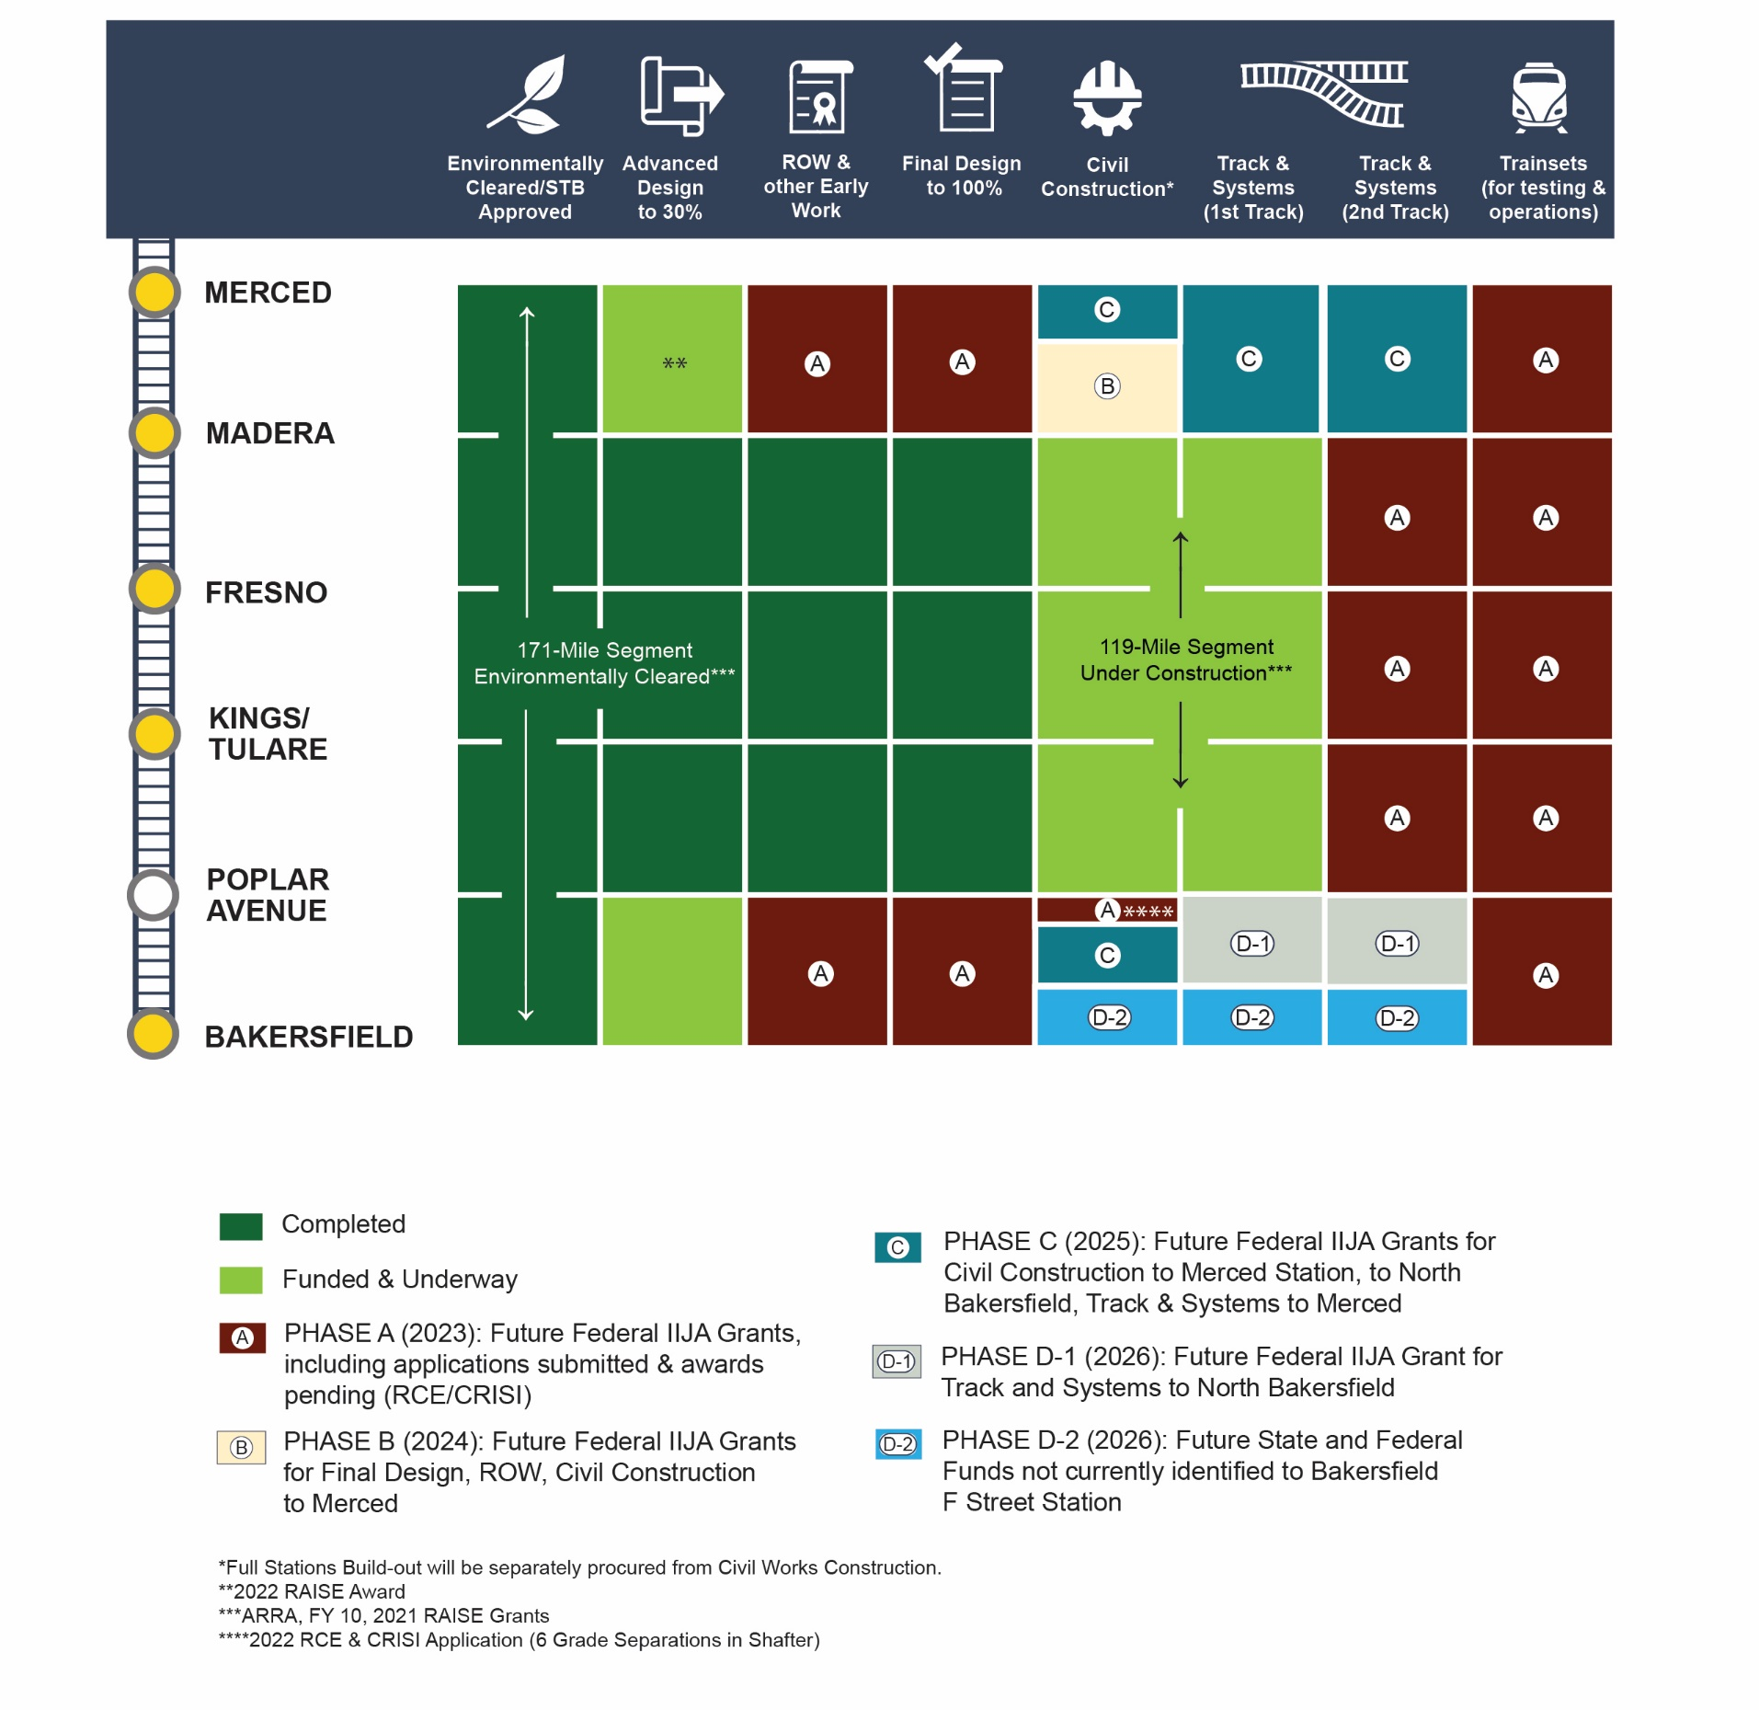
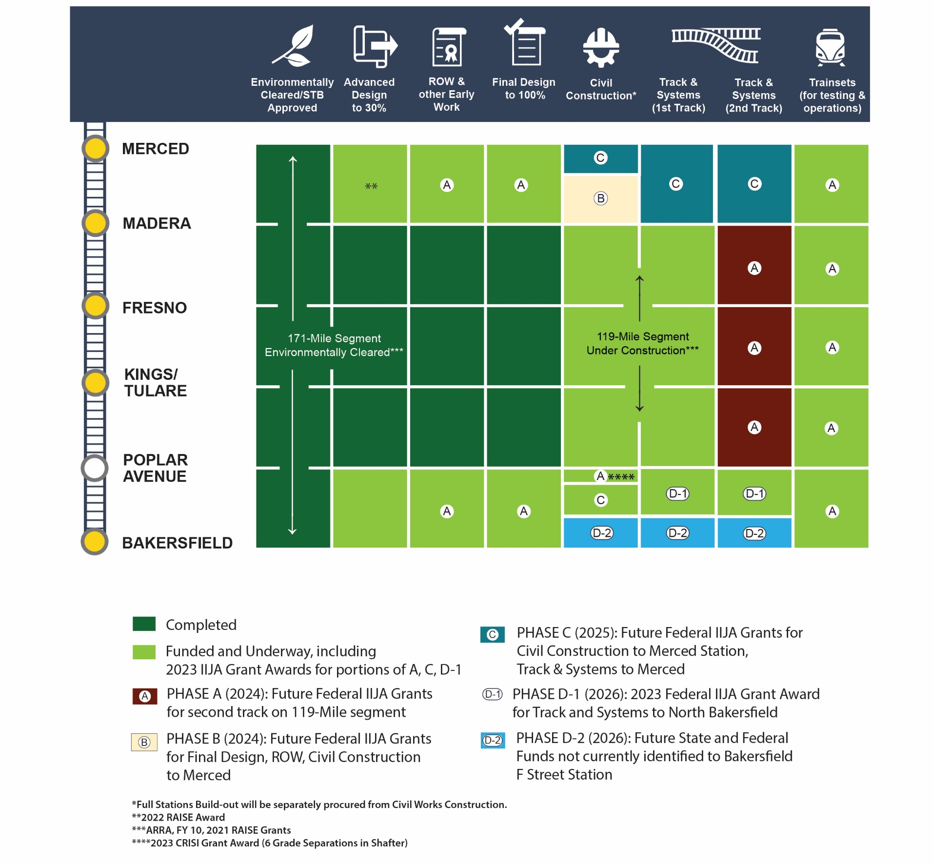
2024 Draft Business Plan – Federal Infusion of Funds
2023 PUR
2024 Business Plan (as of Dec 2023)
Notes:
Recent $3.1 billion federal grant will advance work in California’s Central Valley
Fund six electric trains for testing and use
Fund design and construction of trainset facilities
Fund design and construction of the Fresno station
Fund final design and right-of-way acquisition for the Merced and Bakersfield extensions
Fund civil works, traction power, track, OCS, and systems for Bakersfield Interim Extension

Slide 13
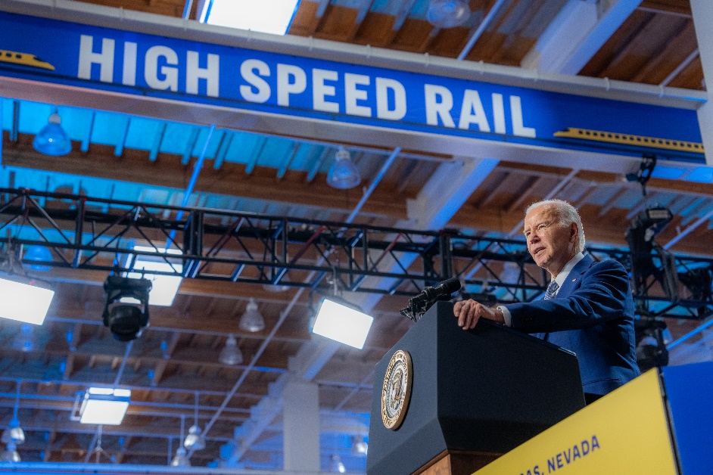
Federal Investments
“Think of how this train will transform California’s Central Valley with new businesses, new residents, visitors, economic opportunities, or what it will mean for people who live in inland towns and commute to work in coastal cities. It’s a game changer.”
- President Joseph Biden Jr.
Recent $3.1 billion federal grant will advance work in California’s Central Valley
Fund six electric trains for testing and use
Fund design and construction of trainset facilities
Fund design and construction of the Fresno station
Fund final design and right-of-way acquisition for the Merced and Bakersfield extensions
Fund civil works, traction power, track, OCS, and systems for Bakersfield Interim Extension

Slide 14
Capital Cost
San Francisco to Los Angeles/Anaheim (Phase 1) Capital Cost Estimates (YOE $ in Millions)
Program Wide Scope Element | Low | Base | High
Merced to Bakersfield | 29,833 | 31,497 | 32,976
Northern California | 21,180 | 27,865 | 35,514
Southern California | 31,908 | 40,650 | 52,807
Program Wide | 5,624 | 6,151 | 6,636
Total | 88,545 | 106,163 | 127,933
Segments outside the Central Valley are typically updated at the time of environmental clearance.
Palmdale to Burbank is scheduled for a cost update in Summer 2024.
LA to Anaheim is scheduled for a cost update in December 2025.
Both segments are expected to have cost updates above the baseline estimate.
Notes:
The 2024 Draft Business Plan carries forward the capital cost forecasts from the 2023 Project Update Report.
Merced to Bakersfield cost estimates were comprehensively updated 11 months ago and haven't significantly changed.

Slide 15
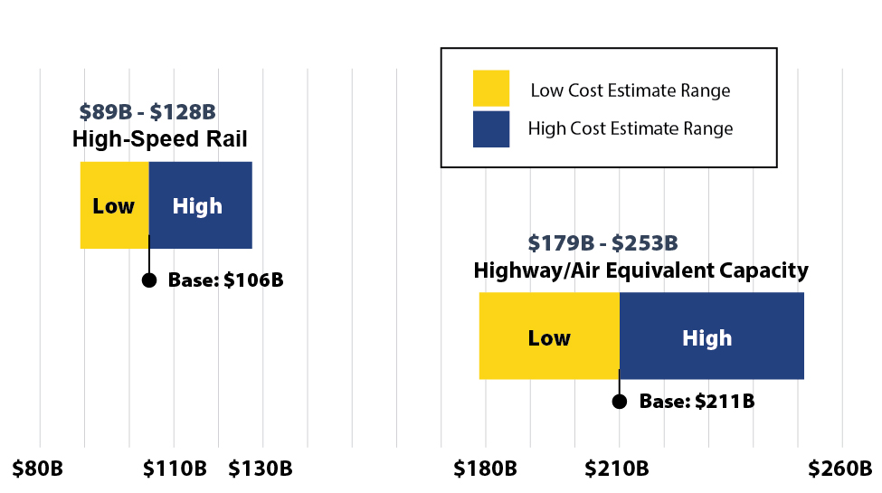
High-Speed Rail Remains Best Value Investment
High-speed rail is the most cost-effective and policy-effective mode of transportation to address intercity transportation needs
High-speed rail cost range of $89 billion to 128 billion
Highway/Air cost range of $179 billion to $253 billion
Updated figures include updated inflation factors from California specific cost indices
Notes:
o High-speed rail is the most cost-effective and policy-effective mode of
transportation to address intercity transportation needs.
o We have compared the cost of Phase I relative to the cost of achieving
equivalent capacity through highway and airport expansions.
o We updated the cost of highway and airport capacity was updated using inflation
factors from California specific cost indices (Caltrans Highway Construction Cost
Index and Department of General Services California Construction Cost Index) to
escalate capacity calculations
o The high-speed rail project is the best value investment with a cost range of $89
billion to $128 billion compared to the cost range of $179 billion to $253 billion
that would be

Slide 16
High-Speed Rail has already reduced emissions and will deliver value for Californians throughout the century.
Legislative Goals | To date HSR has already | In operation HSR will
AB 32 / SB 32: Reduce Greenhouse Gas Emissions | Avoided 123,000 MTCO2e* through recycling and reuse during construction Offset 143,000 MTCO2e through tree planting Sequestered 272,000 MTCO2e through habitat and agricultural land conservation | Deliver 600,000 tons of CO2e reductions annually
AB 32 / SB 32: Provide co-benefits including reductions in air pollution & economic value to Californians | Delivered clean construction with sites that are 65-76% cleaner in terms of reactive organic gases, particulate matter, black carbon, and nitrogen oxides Avoided 500,000 pounds of air pollutants since start of construction | Deliver 1,400 tons of criteria air pollutant reductions annually
SB 535 / AB 1550 directed investments to focus on meaningful and assured benefits to disadvantaged communities (DAC) | Delivered $220 million in wages to disadvantaged workers Provided thousands of living wage jobs ($45/hr) for the more than 65% of workers who live in DAC Invested $5.5 Billion in DAC; more than 50% of total investment Employed more than 215 small business located in DAC | Deliver 7,200 future jobs over 10 years in operations and maintenance
*Metric ton carbon dioxide equivalent
Notes:
More than 90% of the 4,000 vehicles and construction equipment used on the project comply with Tier 4 standards.
Disadvantaged communities in California are specifically targeted for investment of proceeds from the state’s Cap-and-Trade Program. These investments are aimed at improving public health, quality of life and economic opportunity in California’s most burdened communities, and at the same time, reducing pollution that causes climate change. The investments are authorized by the California Global Warming Solutions Act of 2006 (Assembly Bill 32, Nunez, 2016).
In 2012, Senate Bill (SB) 535 (De León, Chapter 830, Statutes of 2012) established initial requirements for minimum funding levels to “Disadvantaged Communities” (DACs). The legislation also gives CalEPA the responsibility for identifying those communities, stating that CalEPA’s designation of disadvantaged communities must be based on “geographic, socioeconomic, public health, and environmental hazard criteria”.
In 2016, Assembly Bill (AB) 1550 (Gomez, Chapter 369, Statutes of 2016) directed CalEPA to identify DACs and also established the currently applicable minimum funding levels:
At least 25 percent of funds must be allocated toward DACs
At least 5 percent must be allocated toward projects within low-income communities or benefiting low-income households
At least 5 percent must be allocated toward projects within and benefiting low-income communities, or low-income households, that are outside of a CalEPA-defined DAC but within ½ mile of a disadvantaged community.
From the Project inception through June 30, 2022, over $1.3 billion has been paid to certified small businesses, Disadvantaged Business Enterprises (DBE), and Disabled Veteran Business Enterprises (DVBE). Of that amount, $570 million was earned by small businesses, $593 million was paid to DBE, and $215 million received by DVBE.
As of June 2022, more than 8,000 construction labor workers have been dispatched to the three high-speed rail construction packages in the Central Valley. Each of the project’s design-builders is implementing the Targeted Worker Program, where 30 percent of all project work hours are performed by workers from disadvantaged communities where annual household incomes range from $32,000 to $40,000. Out of the 8,011 jobs created, 2,683 went to residents from Fresno County, 1,533 from Kern County, 255 from Kings County, 353 from Madera County, and 774 from Tulare County.

Slide 17
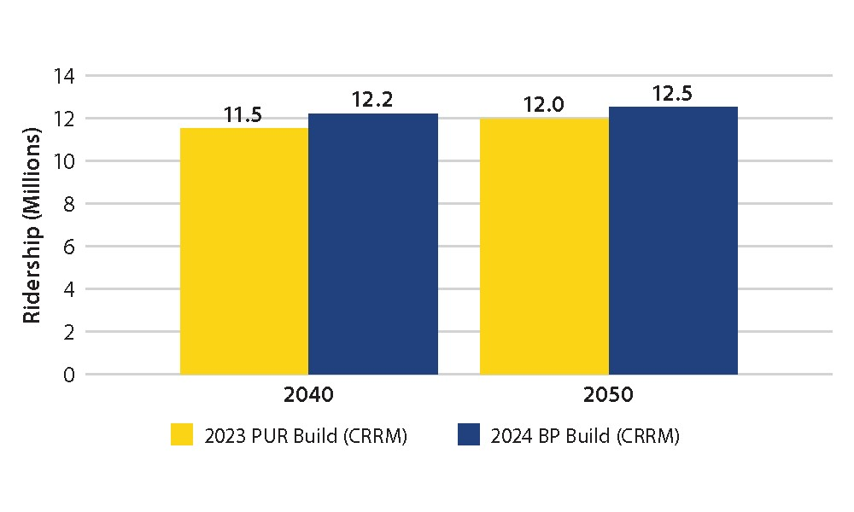
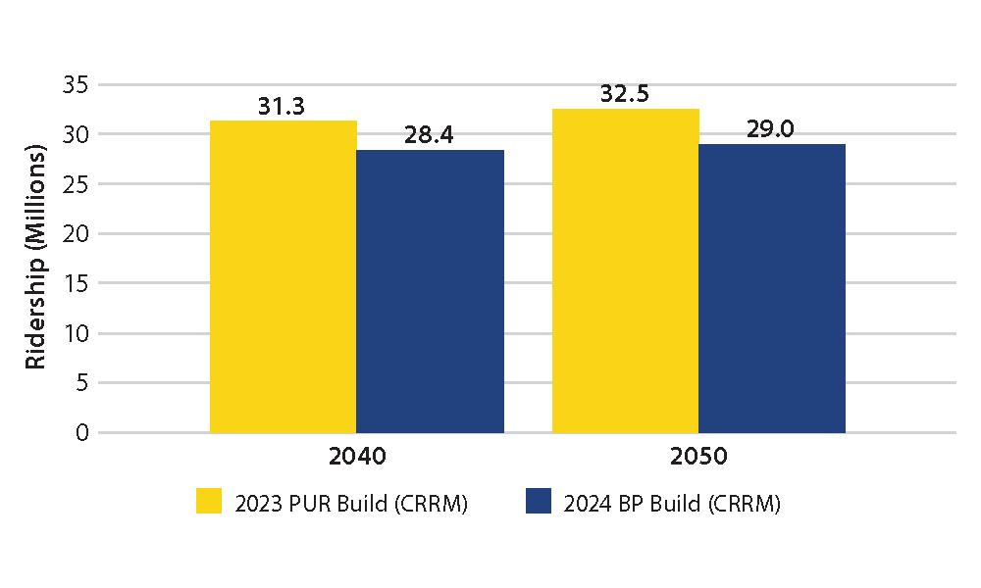
Ridership Projections
Ridership: Stagnant population in California continues to limit long-term ridership projections. However, 2024 Business Plan updates are largely in line with 2023 PUR:
* Central Valley ridership forecasts are in progress, being developed in collaboration with the various stakeholders involved in the Central Valley Service.
Valley to Valley
Phase 1
Notes:
Ridership
• Recent trends in public transportation use create a complex picture for all major
transportation systems in the United States.
• While there has been a modest uptick in projected ridership in the Valley-to-
Valley segment from the 2023 PUR, the numbers remain lower than reported
before the pandemic, primarily due to a decrease in California population
projections.
• Ridership forecasts indicate that high-speed rail in the Merced to Bakersfield
segment will double current rail ridership due to significant travel time
improvements and improved rail connectivity is increase.
• The full 494-mile Phase 1 System from San Francisco to Los Angeles/Anaheim
is projected to serve 28.4 million riders by 2040, demonstrating substantial
mobility benefits and reduced greenhouse gas emissions compared to prepandemic
intercity services.
• Moving forward, efforts will be focused on refining the integrated service plan,
modernizing fare policies, and engaging in necessary agreements to further
enhance ridership.

Slide 18
Risk
Achievements include
Improved and accelerated parcel acquisition in the Central Valley
Resolution of commercial issues
Settlement with the Burbank-Glendale-Pasadena Airport Authority
Stay agreements in Bay Area litigation
Completion of the Semitropic Water Storage District canal realignment in Kern County
Top risks include
Funding uncertainty
Third-party management
Workforce planning
Program integration management
Notes:
The Authority has a robust risk management program to identify and address project risks.
Planning, management, and collaboration with stakeholders have improved.

Slide 19
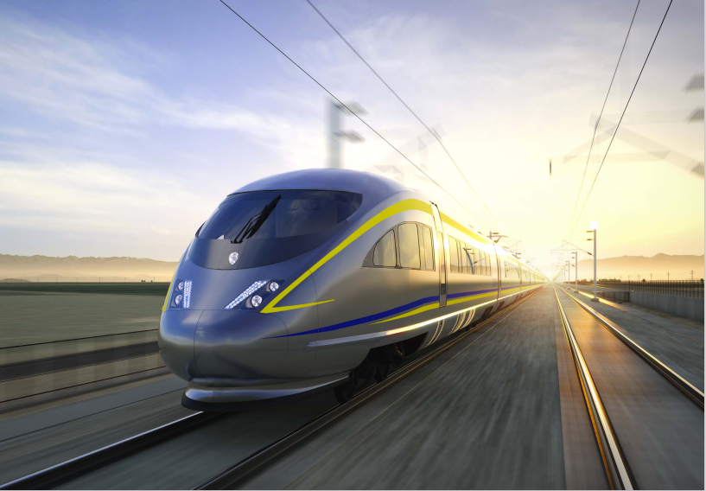
2024 Draft Business Plan – What’s Next
Finish CP 1-4 and design work for Merced (M-M) and Bakersfield (LGA) extensions
Continue environmental review of remaining project sections (Palmdale to Burbank, LA to Anaheim)
Advance collaborative projects in Northern and Southern California regions
Execute procurements to advance rail strategy (Trainsets, Track & Systems, Overhead Contact System)
Continue to work on station designs
Advocate for additional future funding
Our goal remains unchanged: Electrified operating segment between 2030 and 2033

Slide 20
Schedule to Complete Business Plan
February 9 Released Draft Business Plan for 60-day public comment period
February 29 Board Meeting and Public Comment Hearing
March 11 Assembly Transportation Committee Hearing
March 12 Senate Transportation Committee & Budget Subcommittee Hearing
April 11 Board Meeting and Business Plan approval
May 1 Final 2024 Business Plan due to Legislature

Slide 21
How to Provide Public Comment
Today following this presentation
Online comment form through the Draft 2024 Business Plan website at: https://hsr.ca.gov/2024-draft-business-plan-comment-form/
Email: BusinessPlan2024@hsr.ca.gov
U.S. mail to the Authority:
California High-Speed Rail Authority
Attn: Draft 2024 Business Plan
770 L Street, Suite 1180
Sacramento, CA 95814

