Slide 1
Chad Edison
CA State Transportation Agency
Notes:
10/11/2023 – AASHTO Council on Rail Transportation – Annual Meeting
Your role: Keynote/Opening Remarks (10 minutes to present); No Q&A
Time: Event begins at 8:30 a.m.; your role begins at 8:40 a.m.
Where: in person in San Diego at the Westin San Diego Bayview
Approximately 220 Attendees to include transportation professionals, contractors/industry, government officials, community leaders, business leaders.
Some include:
State DOT Rail Directors/Rail Staff, the Office of the Secretary of Transportation, the Federal Railroad Administration, the Federal Highway Administration, Class I RR’s, RR Union Representatives, Shortline Railroads, Private Rail Industry Representatives, Engineering/Consulting Firm Attendees as well.
Summary: AASHTO's Council on Rail Transportation Annual Meeting is an opportunity for members and delegates to engage in peer exchange and technical sessions relating to both freight and passenger rail. As freight rail, intermodal transportation and passenger rail needs at the state and regional level continue to grow, this forum will give attendees an opportunity to engage with industry leaders to exchange information on issues vital to maintaining a strong rail system.
Note:
You will be introduced by AASHTO Council on Rail Chairman Marc Williams, Executive Director – Texas DOT
Good morning! What a year it’s been in rail– and we’re still charging ahead.
Funding, progress and innovation have all been merging to get us to this point, and I’m excited to watch it happening in real time.

Slide 3
Operations along the Merced to Bakersfield Segment
Bruce Armistead, Chief of Rail and Operations Delivery
March 11, 2024

Slide 4
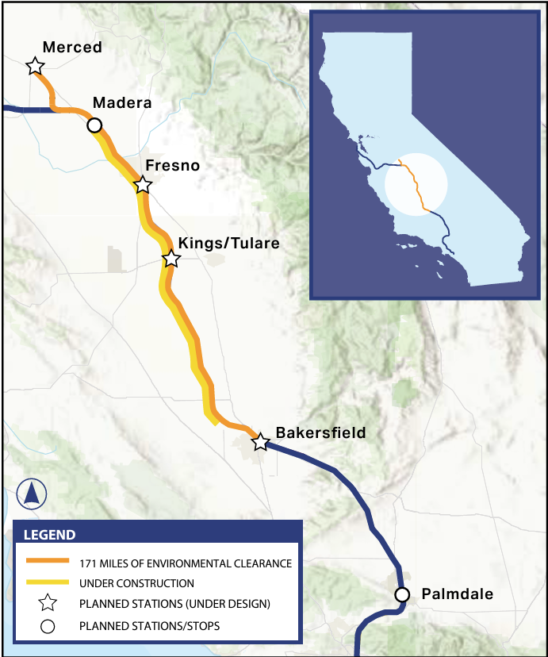
The Central Valley Service will connect millions of Californians to High-Speed Rail
The Central Valley Service will increase systemwide annual ridership to 6.6M
The Central Valley Service almost doubles existing ridership
High-Speed Rail service fare structure will be fully integrated with San Joaquins and ACE services
(1) These improvements are not applicable if high-speed rail is not implemented (No-Build)
Source: CHSR 2024 Draft Business Plan; Project Update Report 2023, & 2022 Business Plan

Slide 5
The High-Speed Rail system takes drivers off the highways and provides a fast, sustainable mode of transportation
The service is planned to consist of:
The service saves:
~499,000 annual hours¹ in passenger travel compared to other rail transportation options
6 High-Speed Rail trainsets for Central Valley Service
Hourly High-Speed Rail service in both directions between Merced & Bakersfield
~97 million fewer miles travelled by private vehicles annually¹
18 daily roundtrips from 5 a.m. to midnight
`
Seamless rail-to-rail and rail-to-bus transfers
92,000 MtCO₂e emissions reduced¹
(~11k homes’ annual energy use)
4 stations built by the Authority
(1) By 2030
Source: 2024 Draft Business Plan; 2023 Project Update Report; 2023 Service Development Plan, & EPA Greenhouse Gas Equivalencies Calculator

Slide 6
This early operating segment will create an employment boom and broad economic output growth in the long-term
Investment in High-Speed Rail sparks labor income and generates value from these activities, driving overall economic output throughout the central valley region¹
$28B
$70B
Labor Income
Economic Output
This economic output is fueled by $28B in labor income and roughly 330,000 job years
Throughout the project, High-Speed Rail will create jobs throughout California and raise overall economic activity via indirect and induced spending
(1) Economic Impact of Total Project ($), CVS Segment – This estimate focuses on the entire CVS, including construction; it excludes additional economic output from increases in efficiency during operations i.e., travel time savings
Source: 2023 Economic Impact Analysis Fact Sheet
Notes:
w

Slide 7
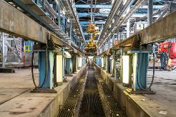
In operation, High-Speed Rail will create jobs and continue to drive economic growth in California: direct, indirect and induced effects
High-Speed Rail impacts the economy via three channels:
High-Speed Rail increases jobs, income and output:
PROGRAM FUNDING
Estimated annual economic impact from staffing High-Speed Rail facilities
$
390
Full Time Employees
DIRECT EFFECTS
Contractors: Construction worker salaries; manufacturing, production
Employees: Salaries, other expenses
$
$
$58.5M¹
in labor income
$
$
INDIRECT EFFECTS
$
INDUCED EFFECTS
Concrete, Steel, Supplies, Transport, Computers, Parts, Office Supplies, and more…
Housing, Groceries, Retail, Recreation, and more…
Every $1 invested creates $4 in economic benefits
$
(1) This estimate is annual, direct only (i.e., salaries) in 2019 dollars, and is operations-focused
Source: CHSR 2023 Service Development Plan, 2023 Sustainability Report, 2023 Economic Impact Report, & APTA

Slide 8
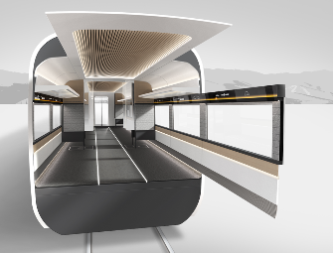
High-Speed Rail’s state-of-the-art American-made trains will have world-class interiors that inspire customers
On board experience / interior design is one of the main drivers of customer satisfaction in high-speed rail
What can Californians expect of the onboard experience?
State-of-the-Art
Resilient
A world-class interior that is accessible by all Californians is important to maximize travel time, comfort, and enjoyment
Passenger centric

Slide 9
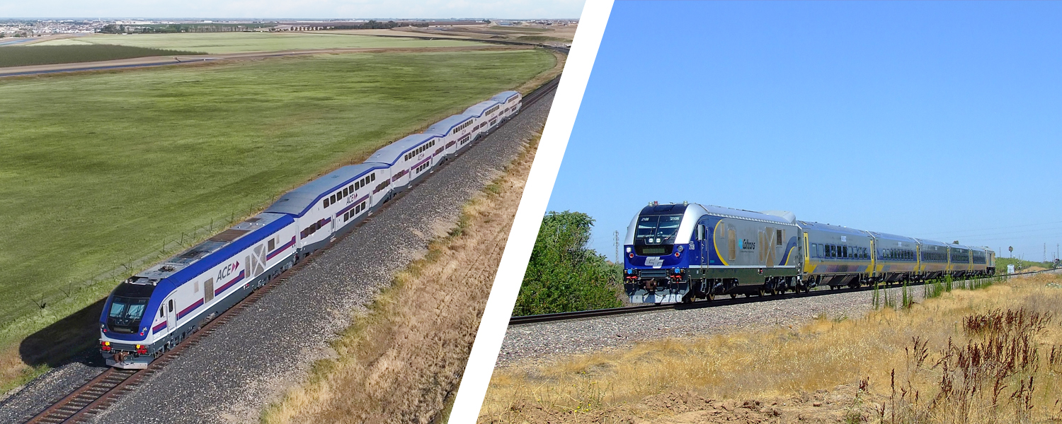
Valley Rail Expansion Program Update
Asm. Transportation Committee: 3/11/24

Slide 10
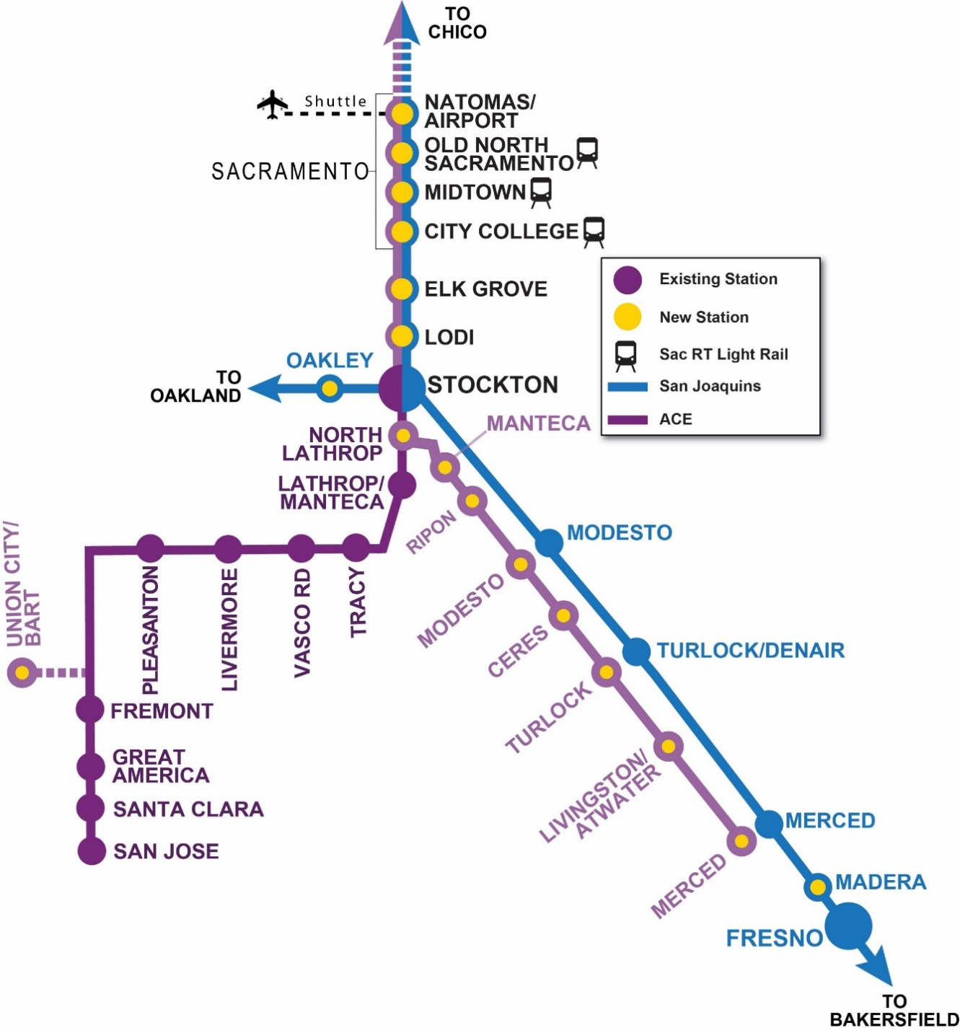
Valley Rail Program includes expansion of both ACE and the San Joaquins Services
Valley Rail has received about $1.6 billion in state and other funding sources
First round-trip to/from Ceres and Natomas by 2026

Slide 11
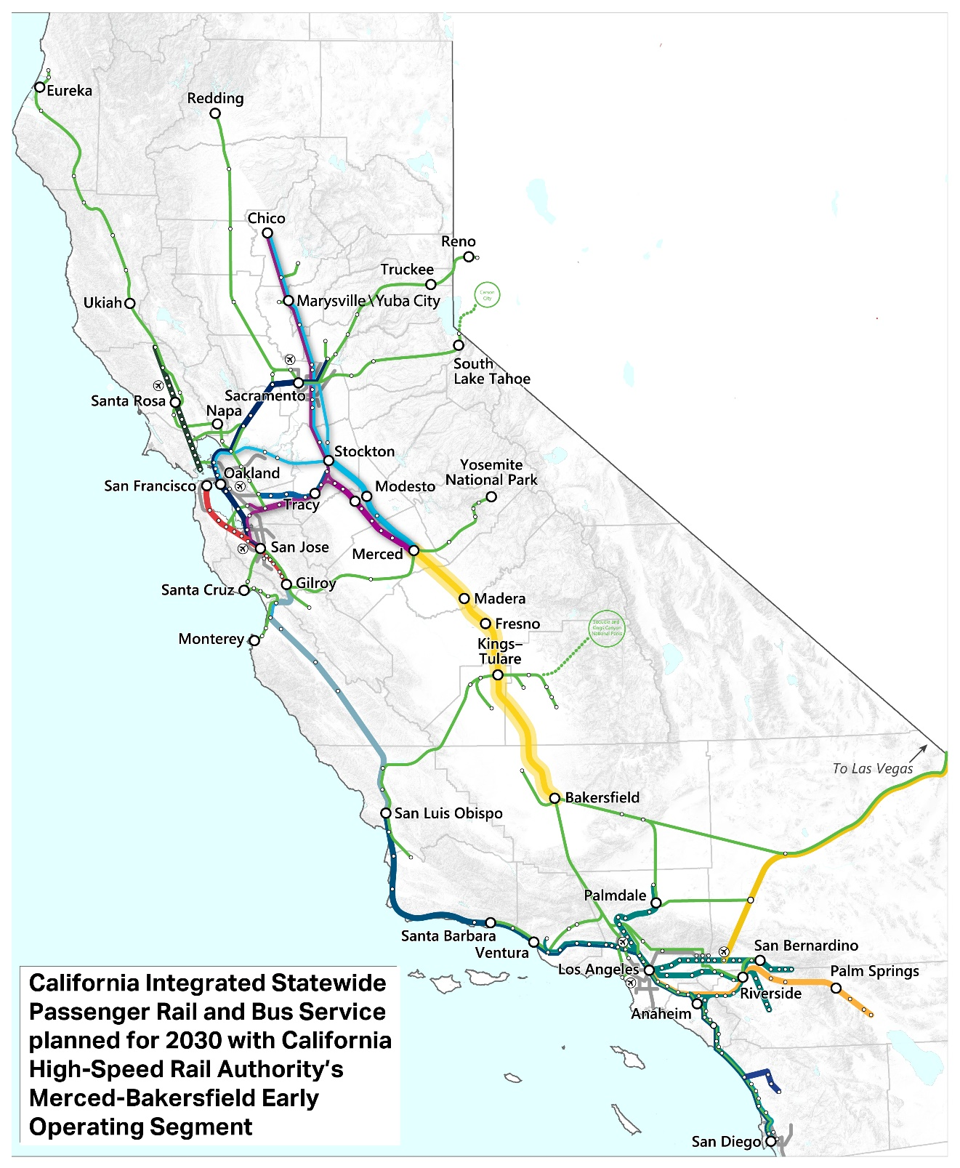
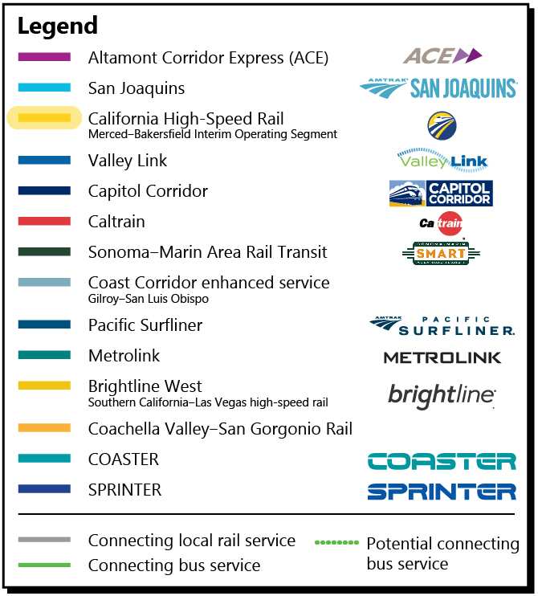

Slide 12
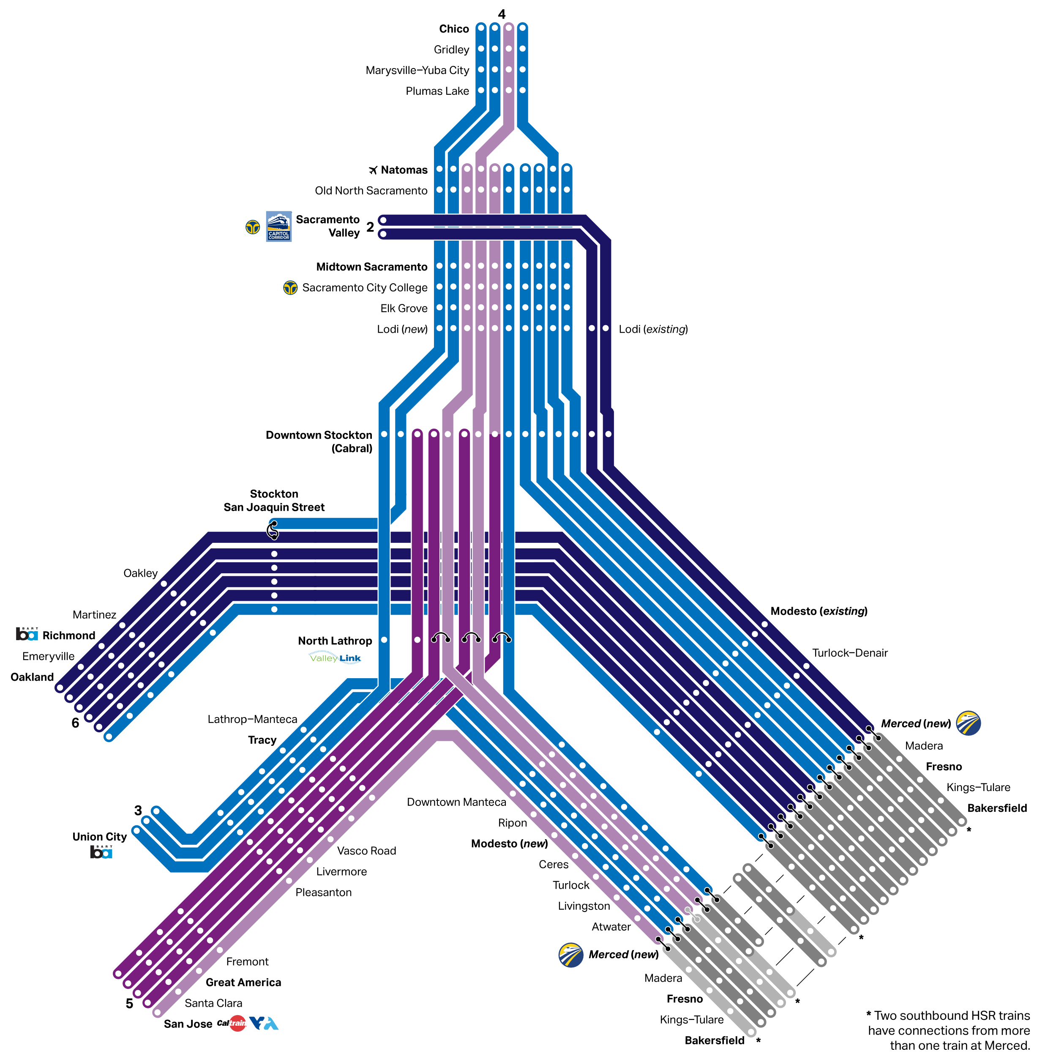
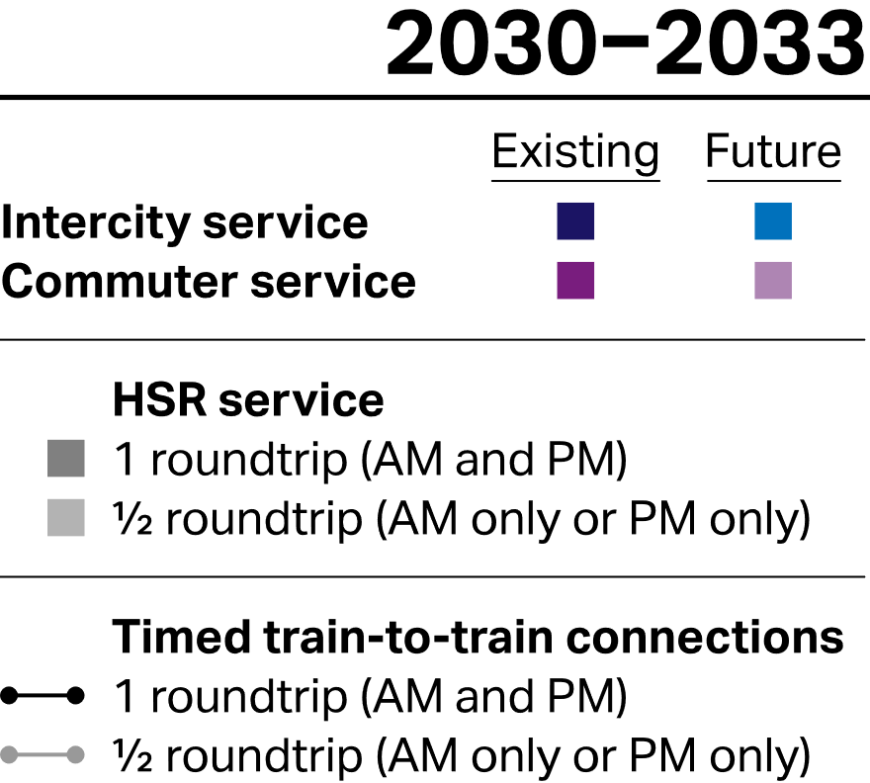
Integrated ACE and San Joaquins

